Slide 1
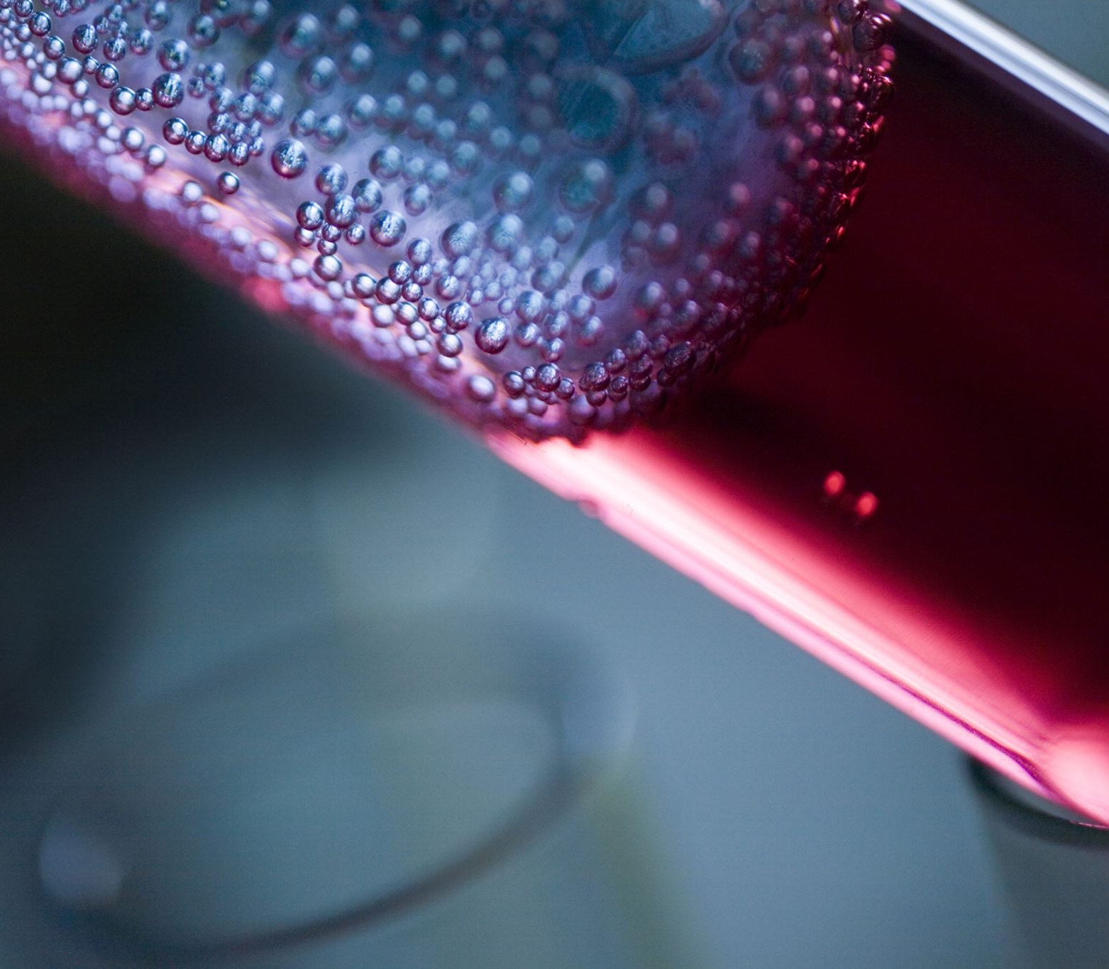
My science fair experiment: HEAT SHOCK and GENETIC ENGINEERING
By Silas Erwin
Hubbell Elementary, 5th grade

Slide 2
Table of contents
Introduction
Hypothesis
Background
My Experiment
Results
Conclusion

Slide 3
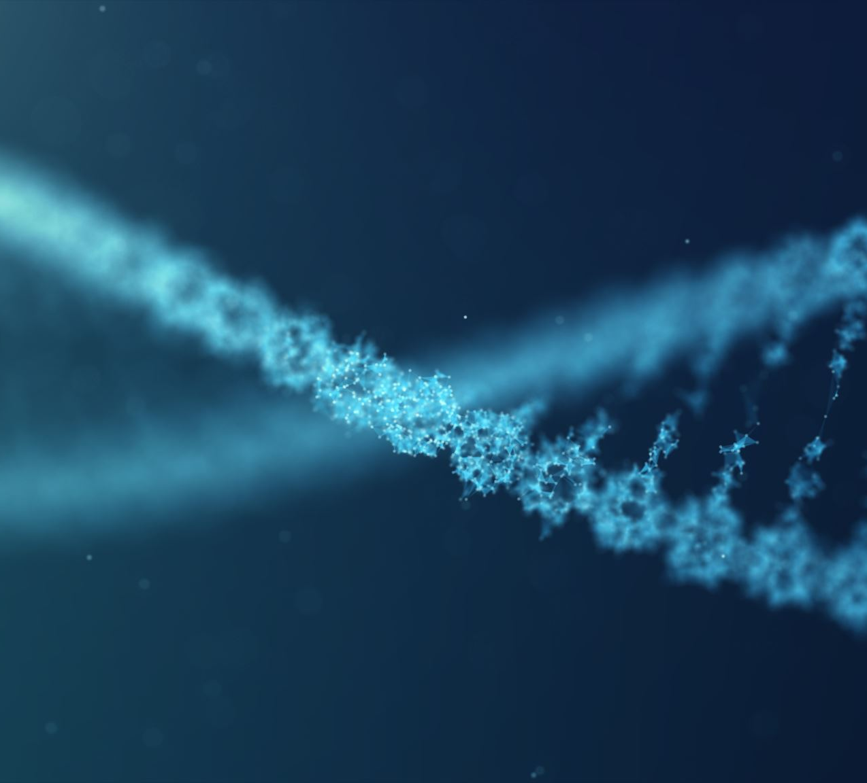
introduction
So, I bet you’re wondering what my experiment is about. Let me tell you. GENETIC ENGINEERING. Yeah.
We do this by taking E. coli bacteria and making them competent cells. We then trick the E. coli into taking chunks of DNA called plasmids from another organism. After all this altering the E.coli should glow under blue light.
For my experiment, I tested the process of making competent cells by leaving out the “heat shock” step that scoots the plasmids into the E. coli.
PS!!! There are videos, click when you see me!

Slide 4
HYPOTHESIS
Inserting plasmids into E. coli depends on the heat shock protocol, and without this step this genetic engineering procedure will not succeed.
link to video

Slide 5
Background: E. coli
E. coli is a bacteria that can cause extremely dangerous foodborne disease. Mostly because it is antibiotic-resistant and there is no known cure. But the strain I am using is about as harmless as yogurt, even if it’s A LOT stinkier!
E.coli is especially good for this experiment because it is easy to make it into a competent cell.
link to video

Slide 6
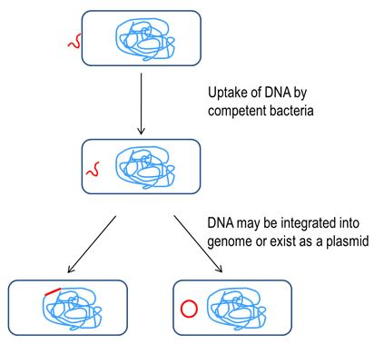
Background: Competent cells
Competent cells are (as per their name) easier to alter. They can easily accept foreign DNA (that’s called transformation).
E. coli isn’t naturally competent, but it’s easy to make it competent by using heat to make pores in its cell membranes.

Slide 7
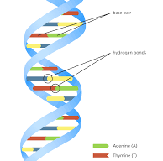
Background: DNA
DNA (deoxyribonucleic acid) is… well… just look below this sentence simplified version: DNA is kind of like an instructor and a library of info for cells. Telling the cell what to do and when to do it. Here are some scenarios where DNA tells cells to make new copies: injury, mitosis, and “eating” complex version: DNA is stored in the nucleus which is the center of the cell. DNA also has genetic code in the spiral helix. Some chemicals that would have been simple on their own like, phosphorus and cytosine are extremely complex when forming DNA. Smaller copies called RNA can be made to form proteins for the body’s cells.

Slide 8
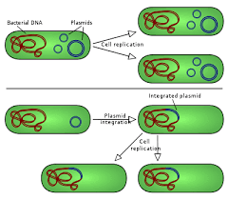
Background: plasmids
You know the drill. Simplified version: plasmids are a small chunk of DNA that can reproduce without a cell. Complex version: plasmids are part of the double helix in DNA and are independent from the chromosomes and can replicate independently. They are mostly found in less complex DNA but can also be found in archaea and eukaryotic organisms. They are often used in the manipulation of genes.

Slide 9
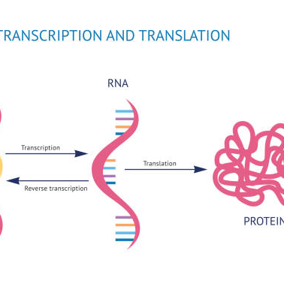
Background: sources
What is DNA?
https://www.yourgenome.org/facts/what-is-dna
What is a plasmid?
https://en.wikipedia.org/wiki/Plasmid
What is a competent cell?
https://www.goldbio.com/articles/article/Introduction-to-Competent-Cells
How do genetic engineers make competent cells?
https://www.the-odin.com/crispr-bacterial-guide/

Slide 10
designing the experiment
Steps for simple(!!!) genetic engineering:
Make agar plate
Incubate E. coli on agar plate
Create the mixture! Take E. coli from plate, add plasmids, add transformation mixture (CaCl2 and polyethylene glycol)
Put mixture on ice
Heat shock
Incubate for 24 hours
Shine light on bacteria to see if it glows!
link to video

Slide 11
designing the experiment
I used a CRISPR genetic engineering kit to insert plasmids of jellyfish DNA into E. coli.
I split the E. coli into two agar plates. The experiment left out the “heat shock” step in the control. In the experimental we did the heat shock. The heat shock weakens the cell membrane of the E. coli, without it I predicted the plasmids wouldn’t go into the bacteria.
See the next page for pictures of the experiment or to just find out what happens click on me!

Slide 12
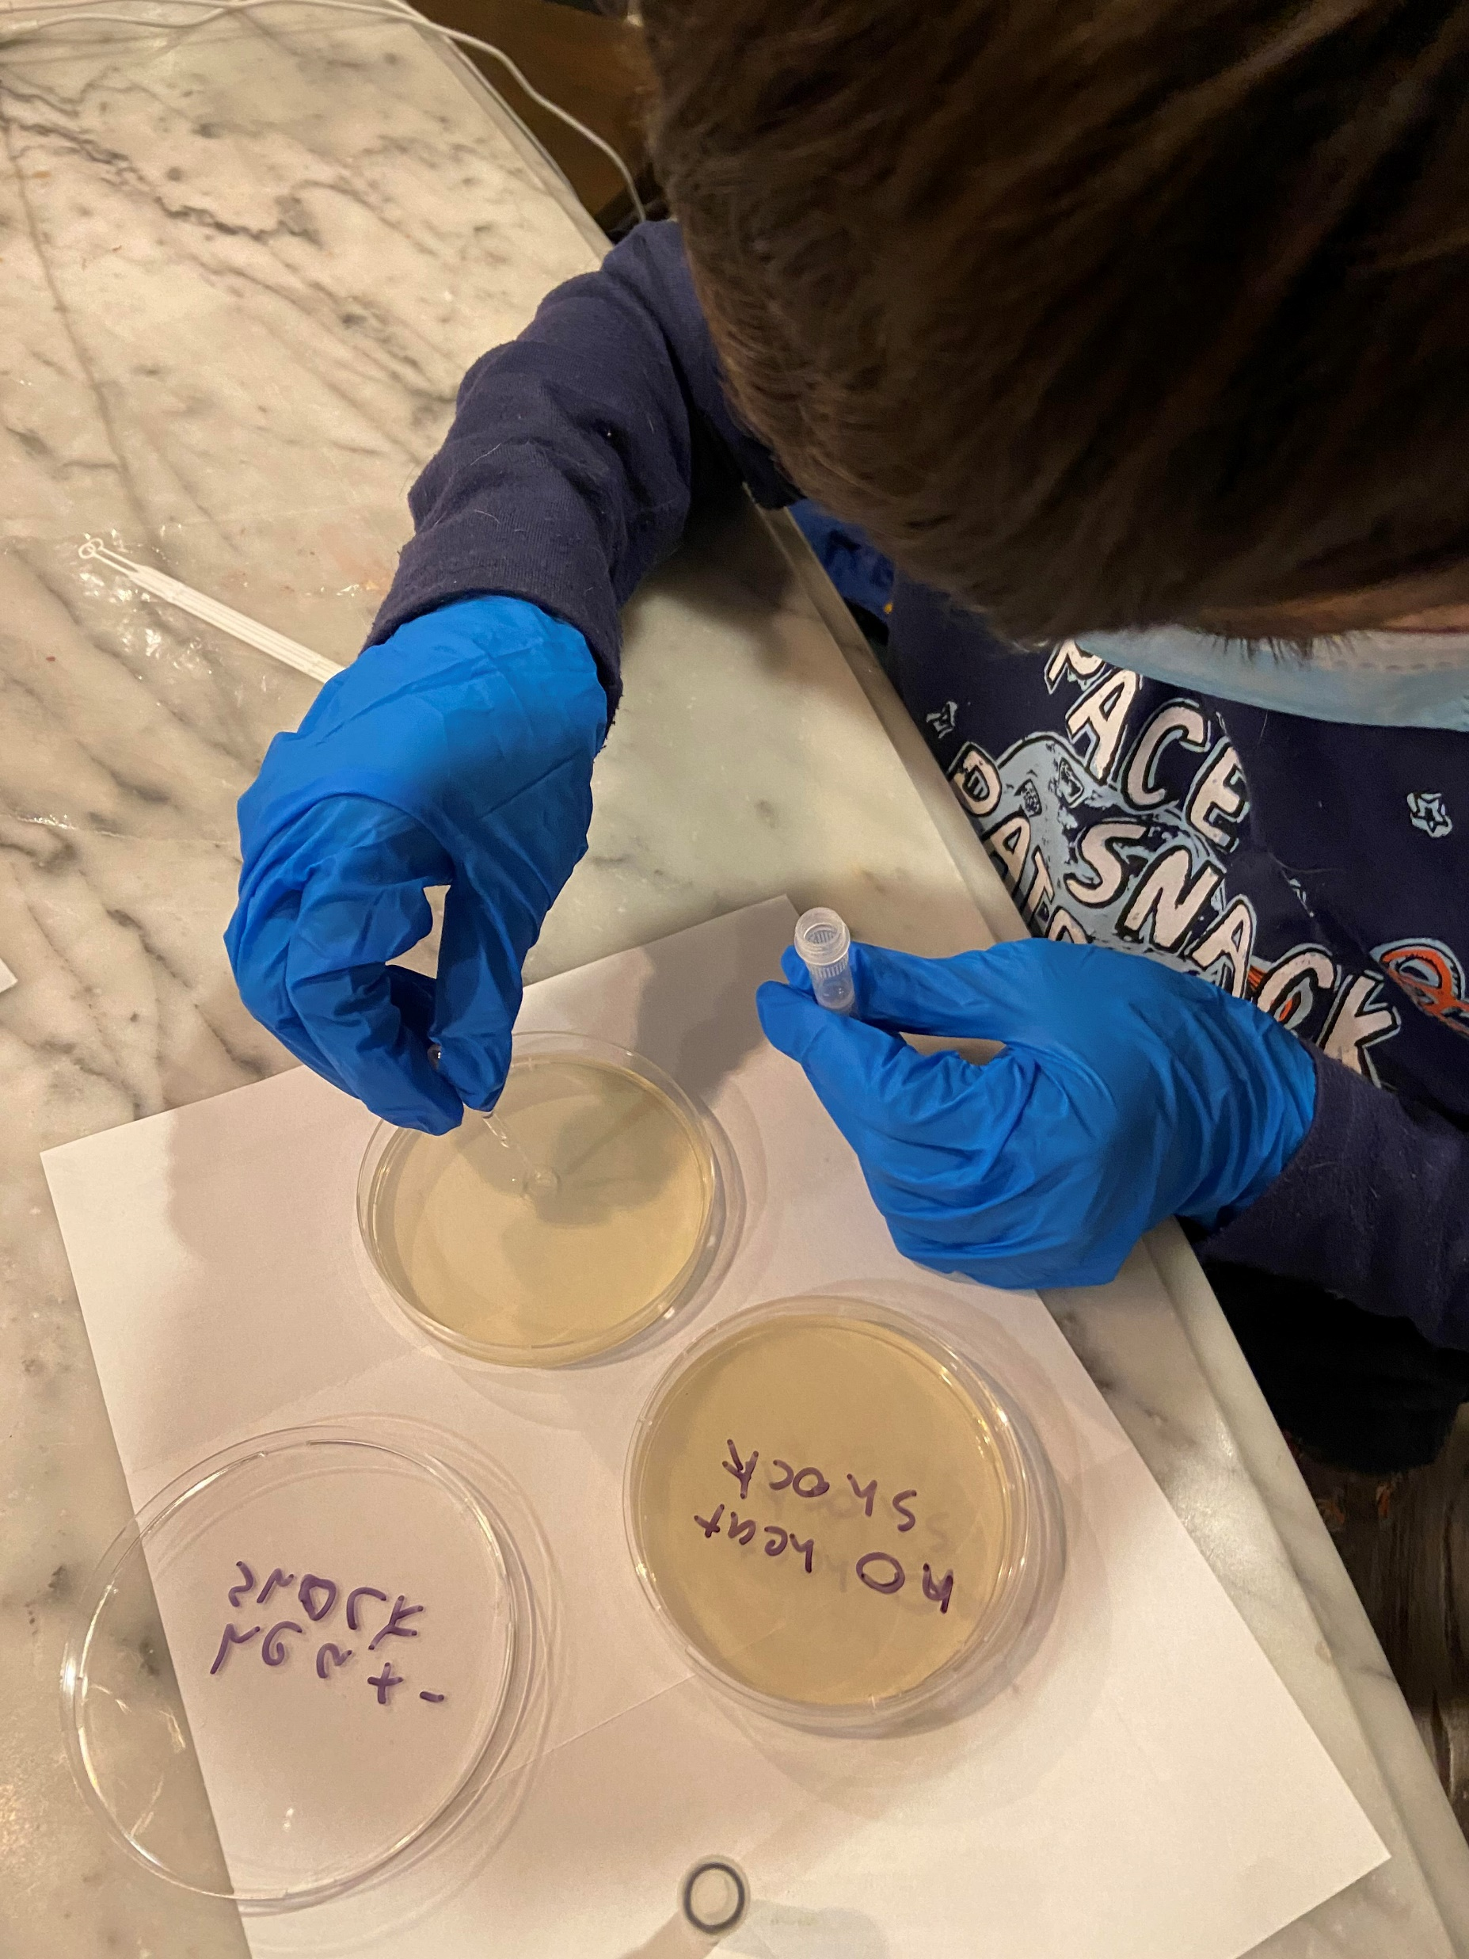
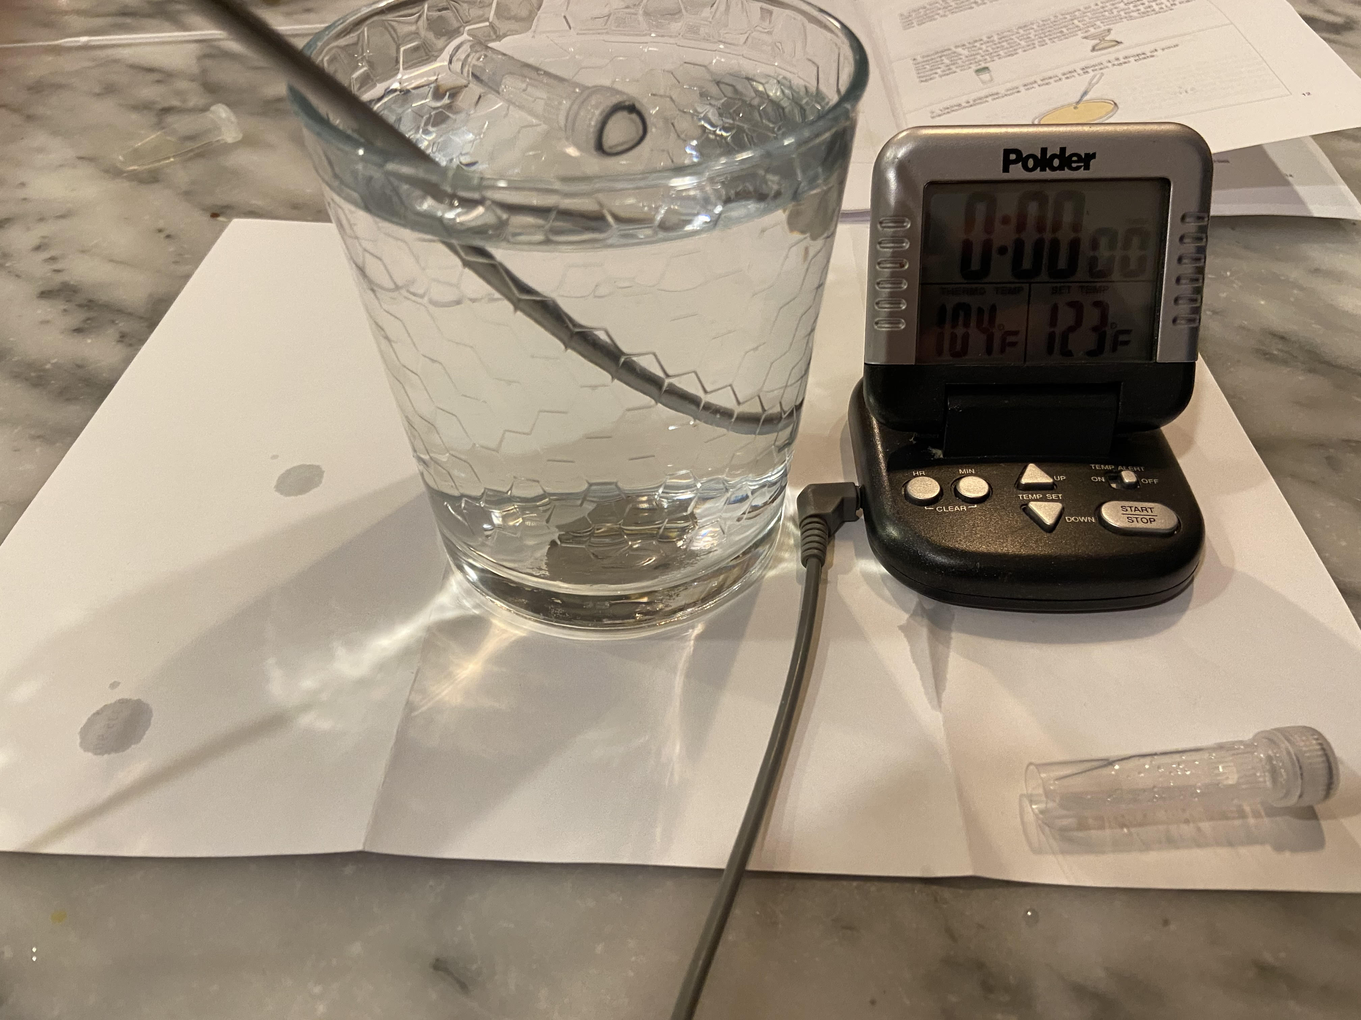
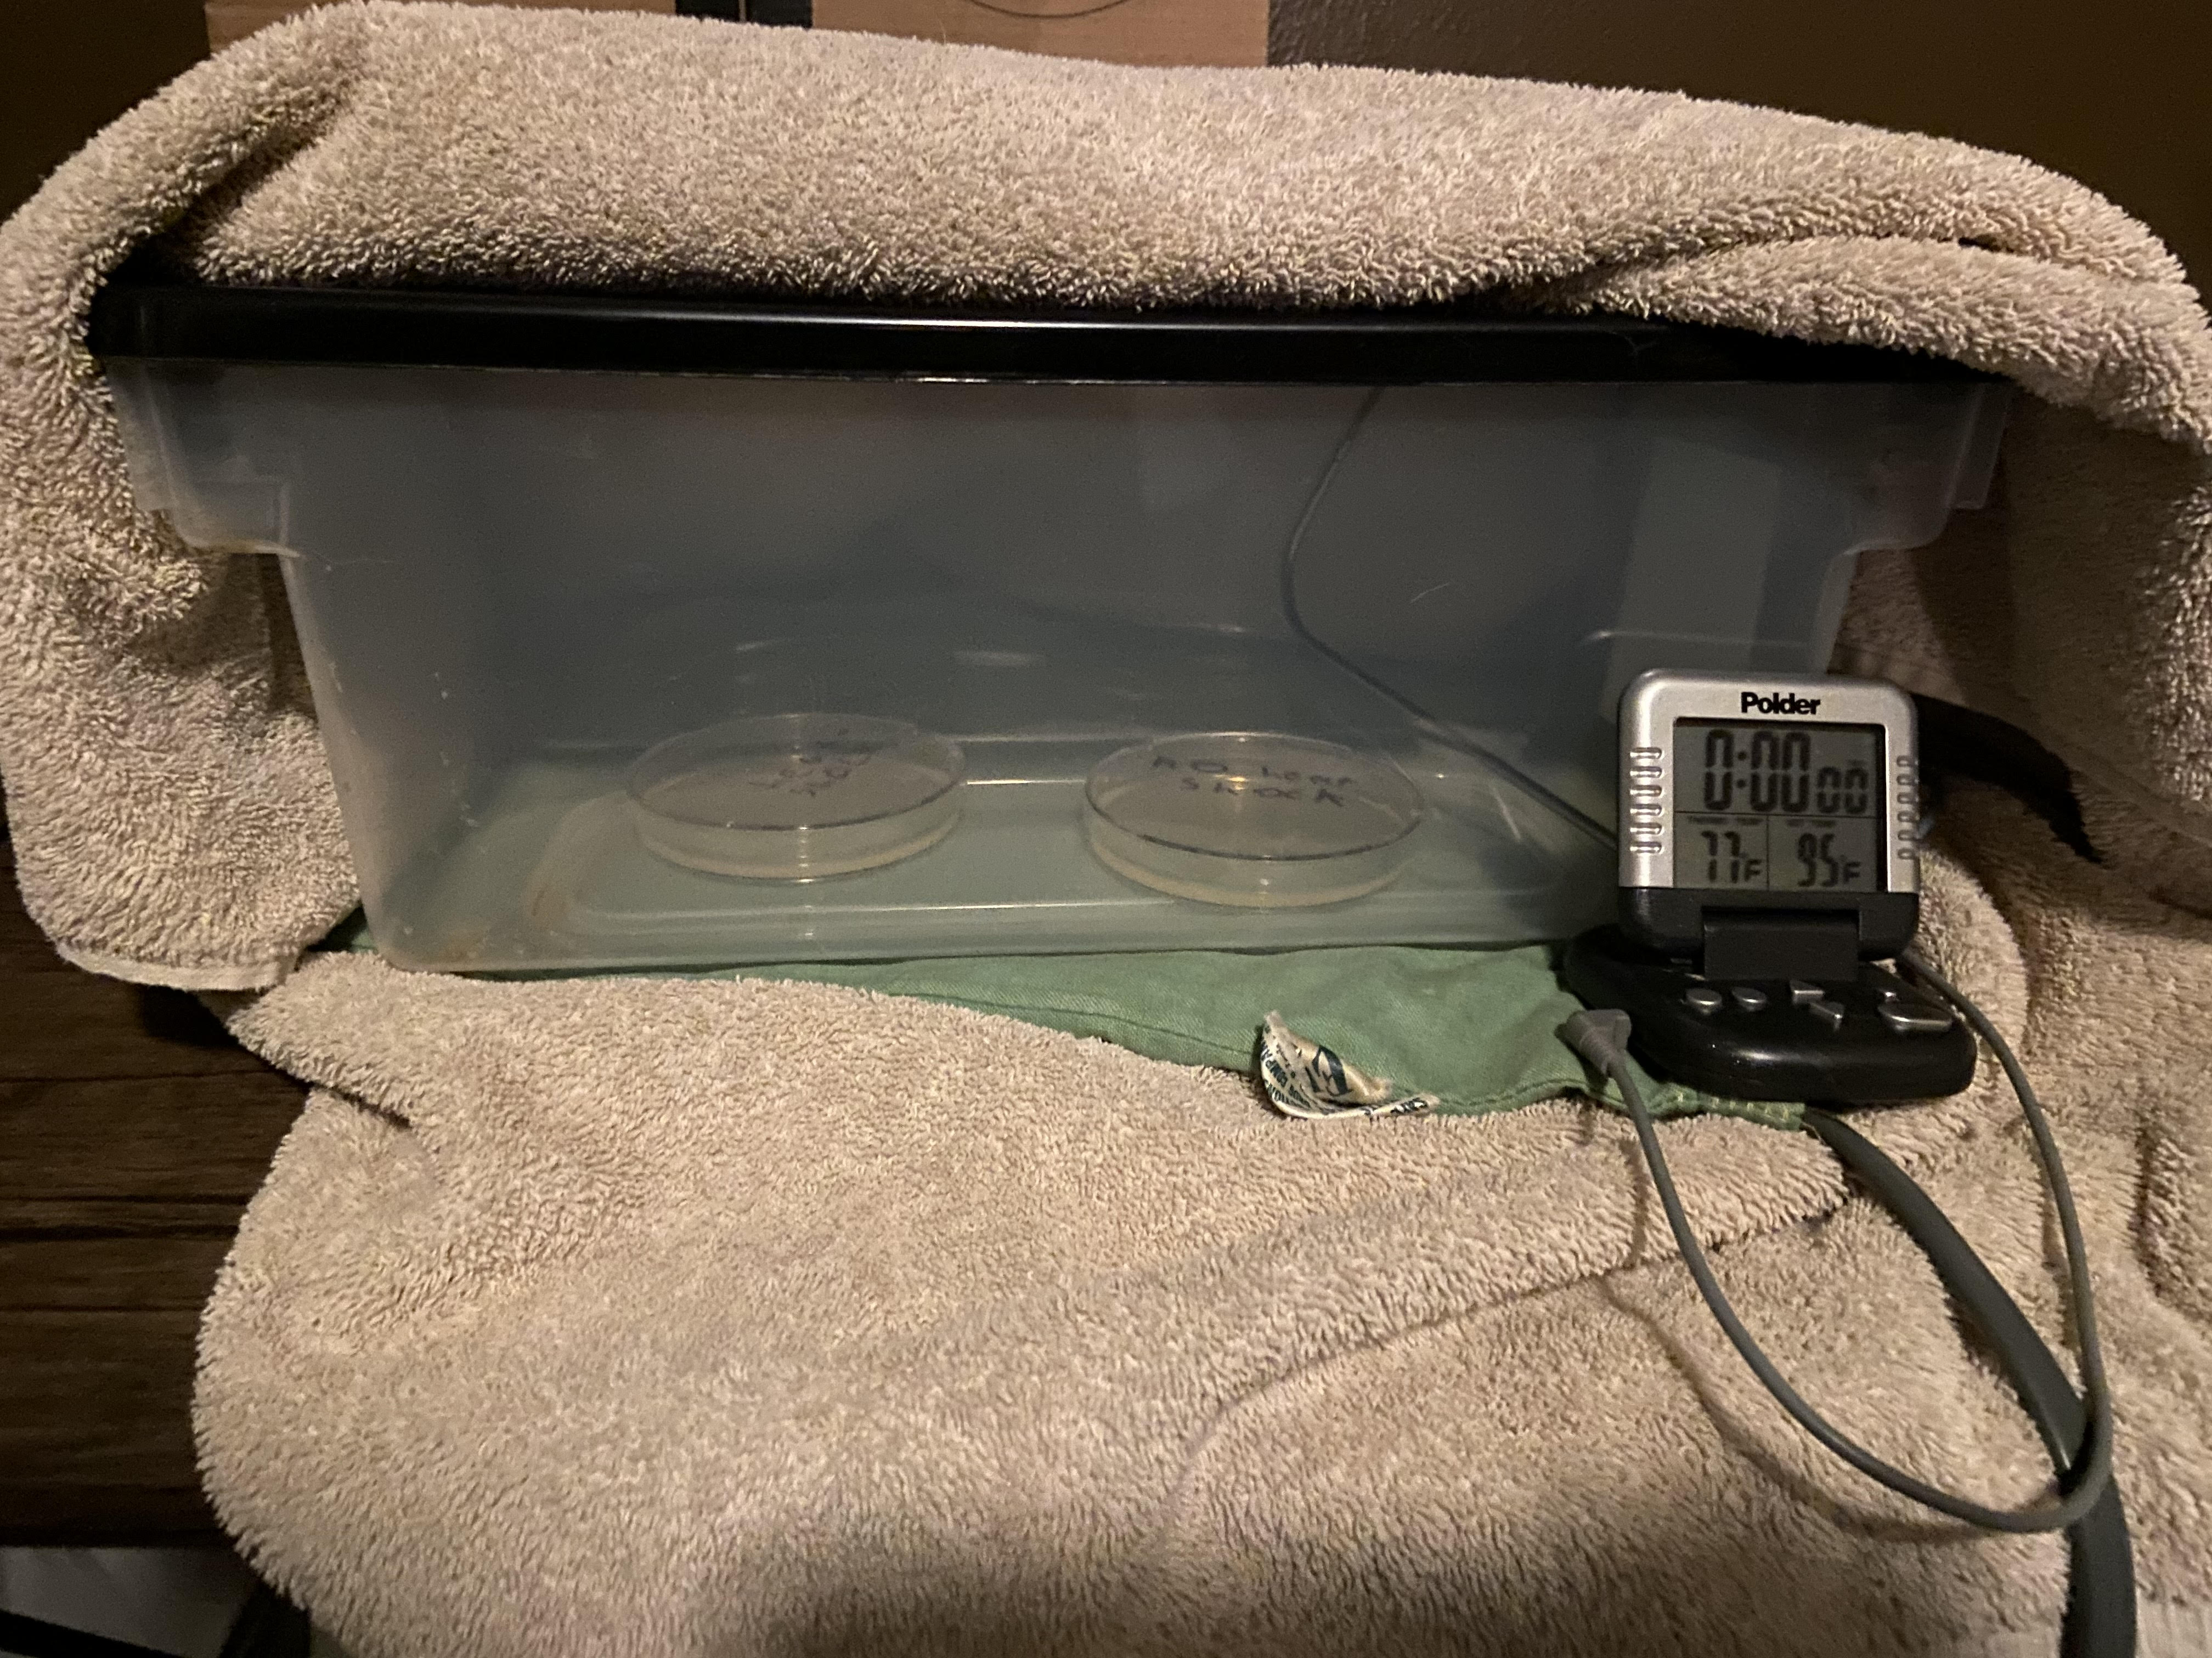
Running the experiment
Harvesting E. coli and adding plasmids
One of these was GENETICALLY ENGINEERED!
HEAT SHOCK!!!!!
Incubation chamber

Slide 13
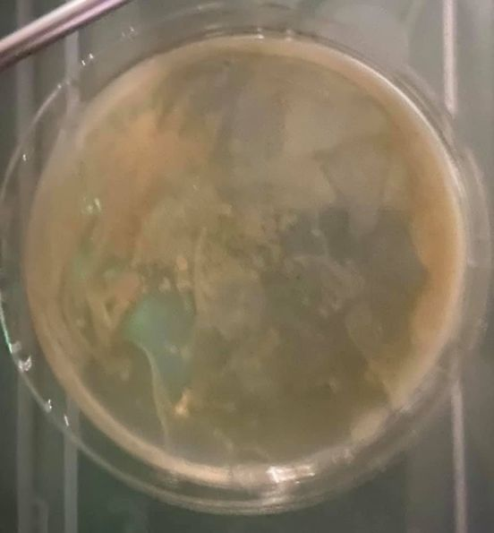
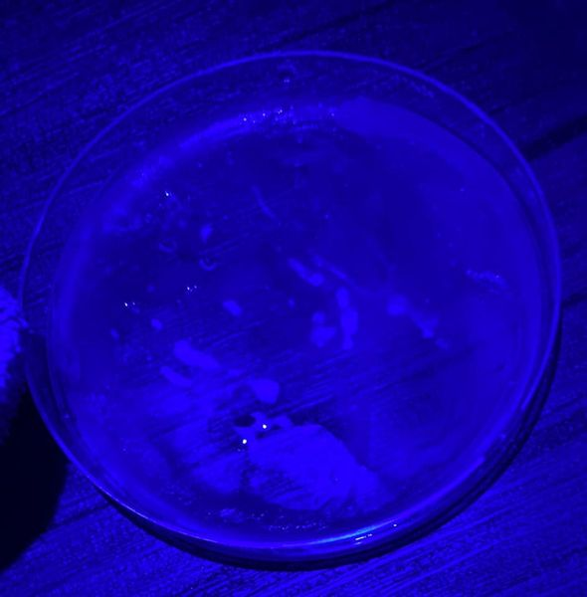
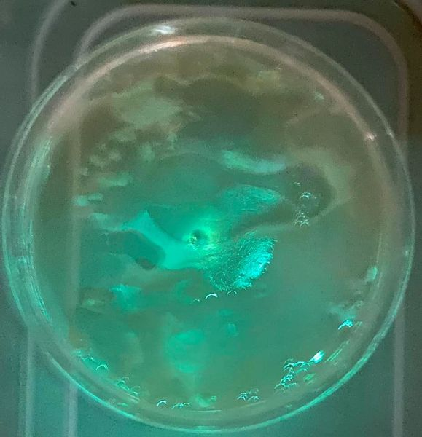
The results
Control under regular and blue light
Experimental under regular and blue light
Bad transformation :(
link to video
Good transformation :)

Slide 14
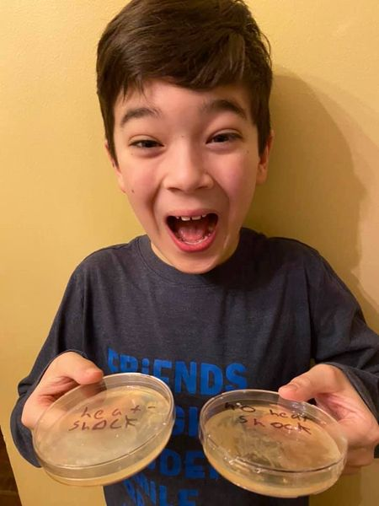
conclusion
The experiment confirmed my hypothesis! (insert applause) Genetic engineering is fun! But maybe I’ll stick to a less stinky bacteria next time! (canned laughter)
link to video

